Slide 1

Coimbatore Road Safety Challenge
Accident Hotspot Prediction and Prevention Systems
Notes:
1

Slide 2

Coimbatore Road Safety Challenge
Accident Hotspot Prediction and Prevention Systems
01
Introduction
02
Content
“Smart Roads, Safer Lives”
03
Problem Statement
04
Objective
Overview: Coimbatore faces an increasing road safety challenge with rising accident rates, fatalities, and traffic density.
Objective: To provide an AI-driven solution for identifying and mitigating accident hotspots, ensuring safer roads and improved traffic management.
05
Proposed Solution
06
Implementation Plan
07
Expected Impact
08
Conclusion
09
Thank You

Slide 3

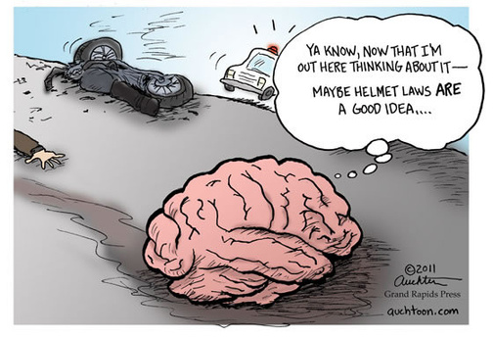
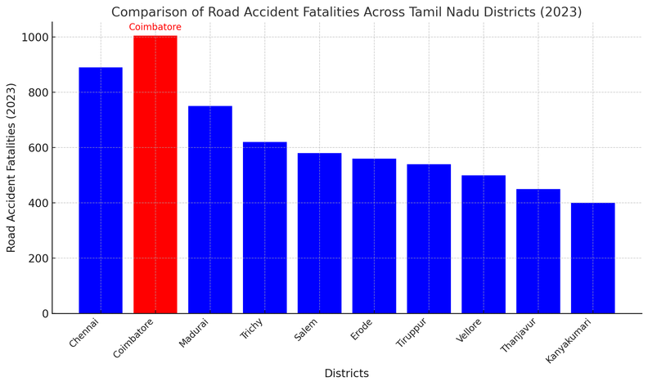
Road Safety Challenges in Coimbatore
High Fatality Rates:
In 2023, Coimbatore reported over 1,000 road accident fatalities, surpassing Chennai as the district with the highest number of such deaths in Tamil Nadu.
Evening Accidents Surge:
There was a significant spike in accidents between 6 PM and 9 PM, with 47 fatal and 104 non-fatal incidents recorded during these hours.
Two-Wheeler Incidents:
Tamil Nadu recorded 8,113 two-wheeler accident deaths in 2023, with many attributed to non-helmet use.
Infrastructure Gaps:
Poorly managed intersections, insufficient road infrastructure, and limited real-time traffic monitoring systems exacerbate the problem.

Slide 4
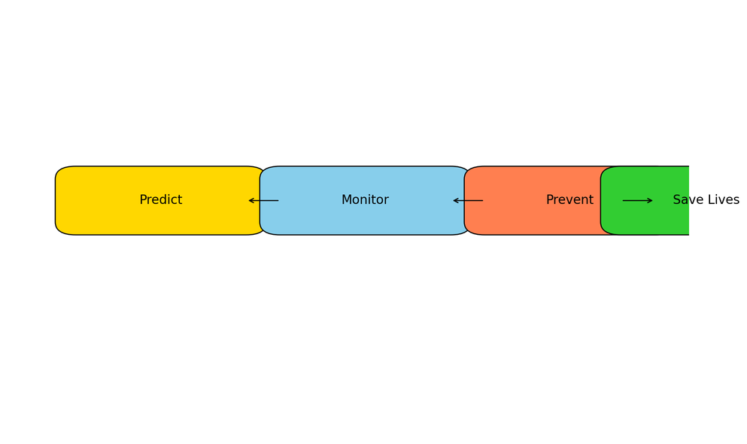
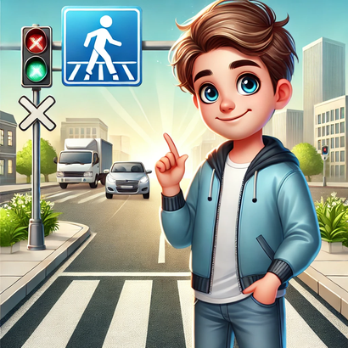
Our Mission
Primary Goal: Reduce accidents and fatalities by 30-40% at identified hotspots.
Key Focus Areas:
Predict accident hotspots using AI and data analytics.
Prevent accidents with real-time interventions and community awareness.
Enhance road safety and urban planning through actionable insights.
a person who was saved and is feeling relieved and happy

Slide 5
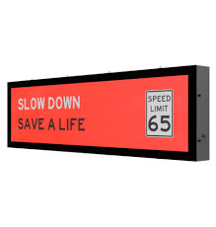
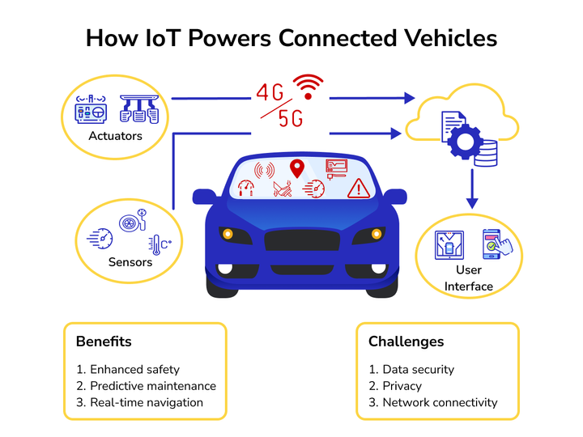

Accident Hotspot Prediction and Prevention System
Data Collection:
Traffic data from IoT sensors, GPS devices, and cameras.
Historical accident data and environmental factors.
Prediction Model:
AI/ML algorithms (e.g., Random Forest, Gradient Boosting) for hotspot forecasting.
Real-Time Monitoring:
IoT devices and camera feeds for tracking speed, density, and conditions.
Prevention Mechanisms:
Dynamic warning signs, mobile app notifications, and smart traffic lights.
Government Dashboard:
Interactive interface for traffic officials to plan interventions.
Dynamic warning signs

Slide 6
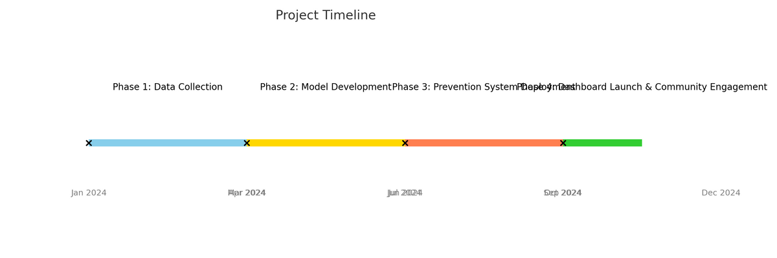
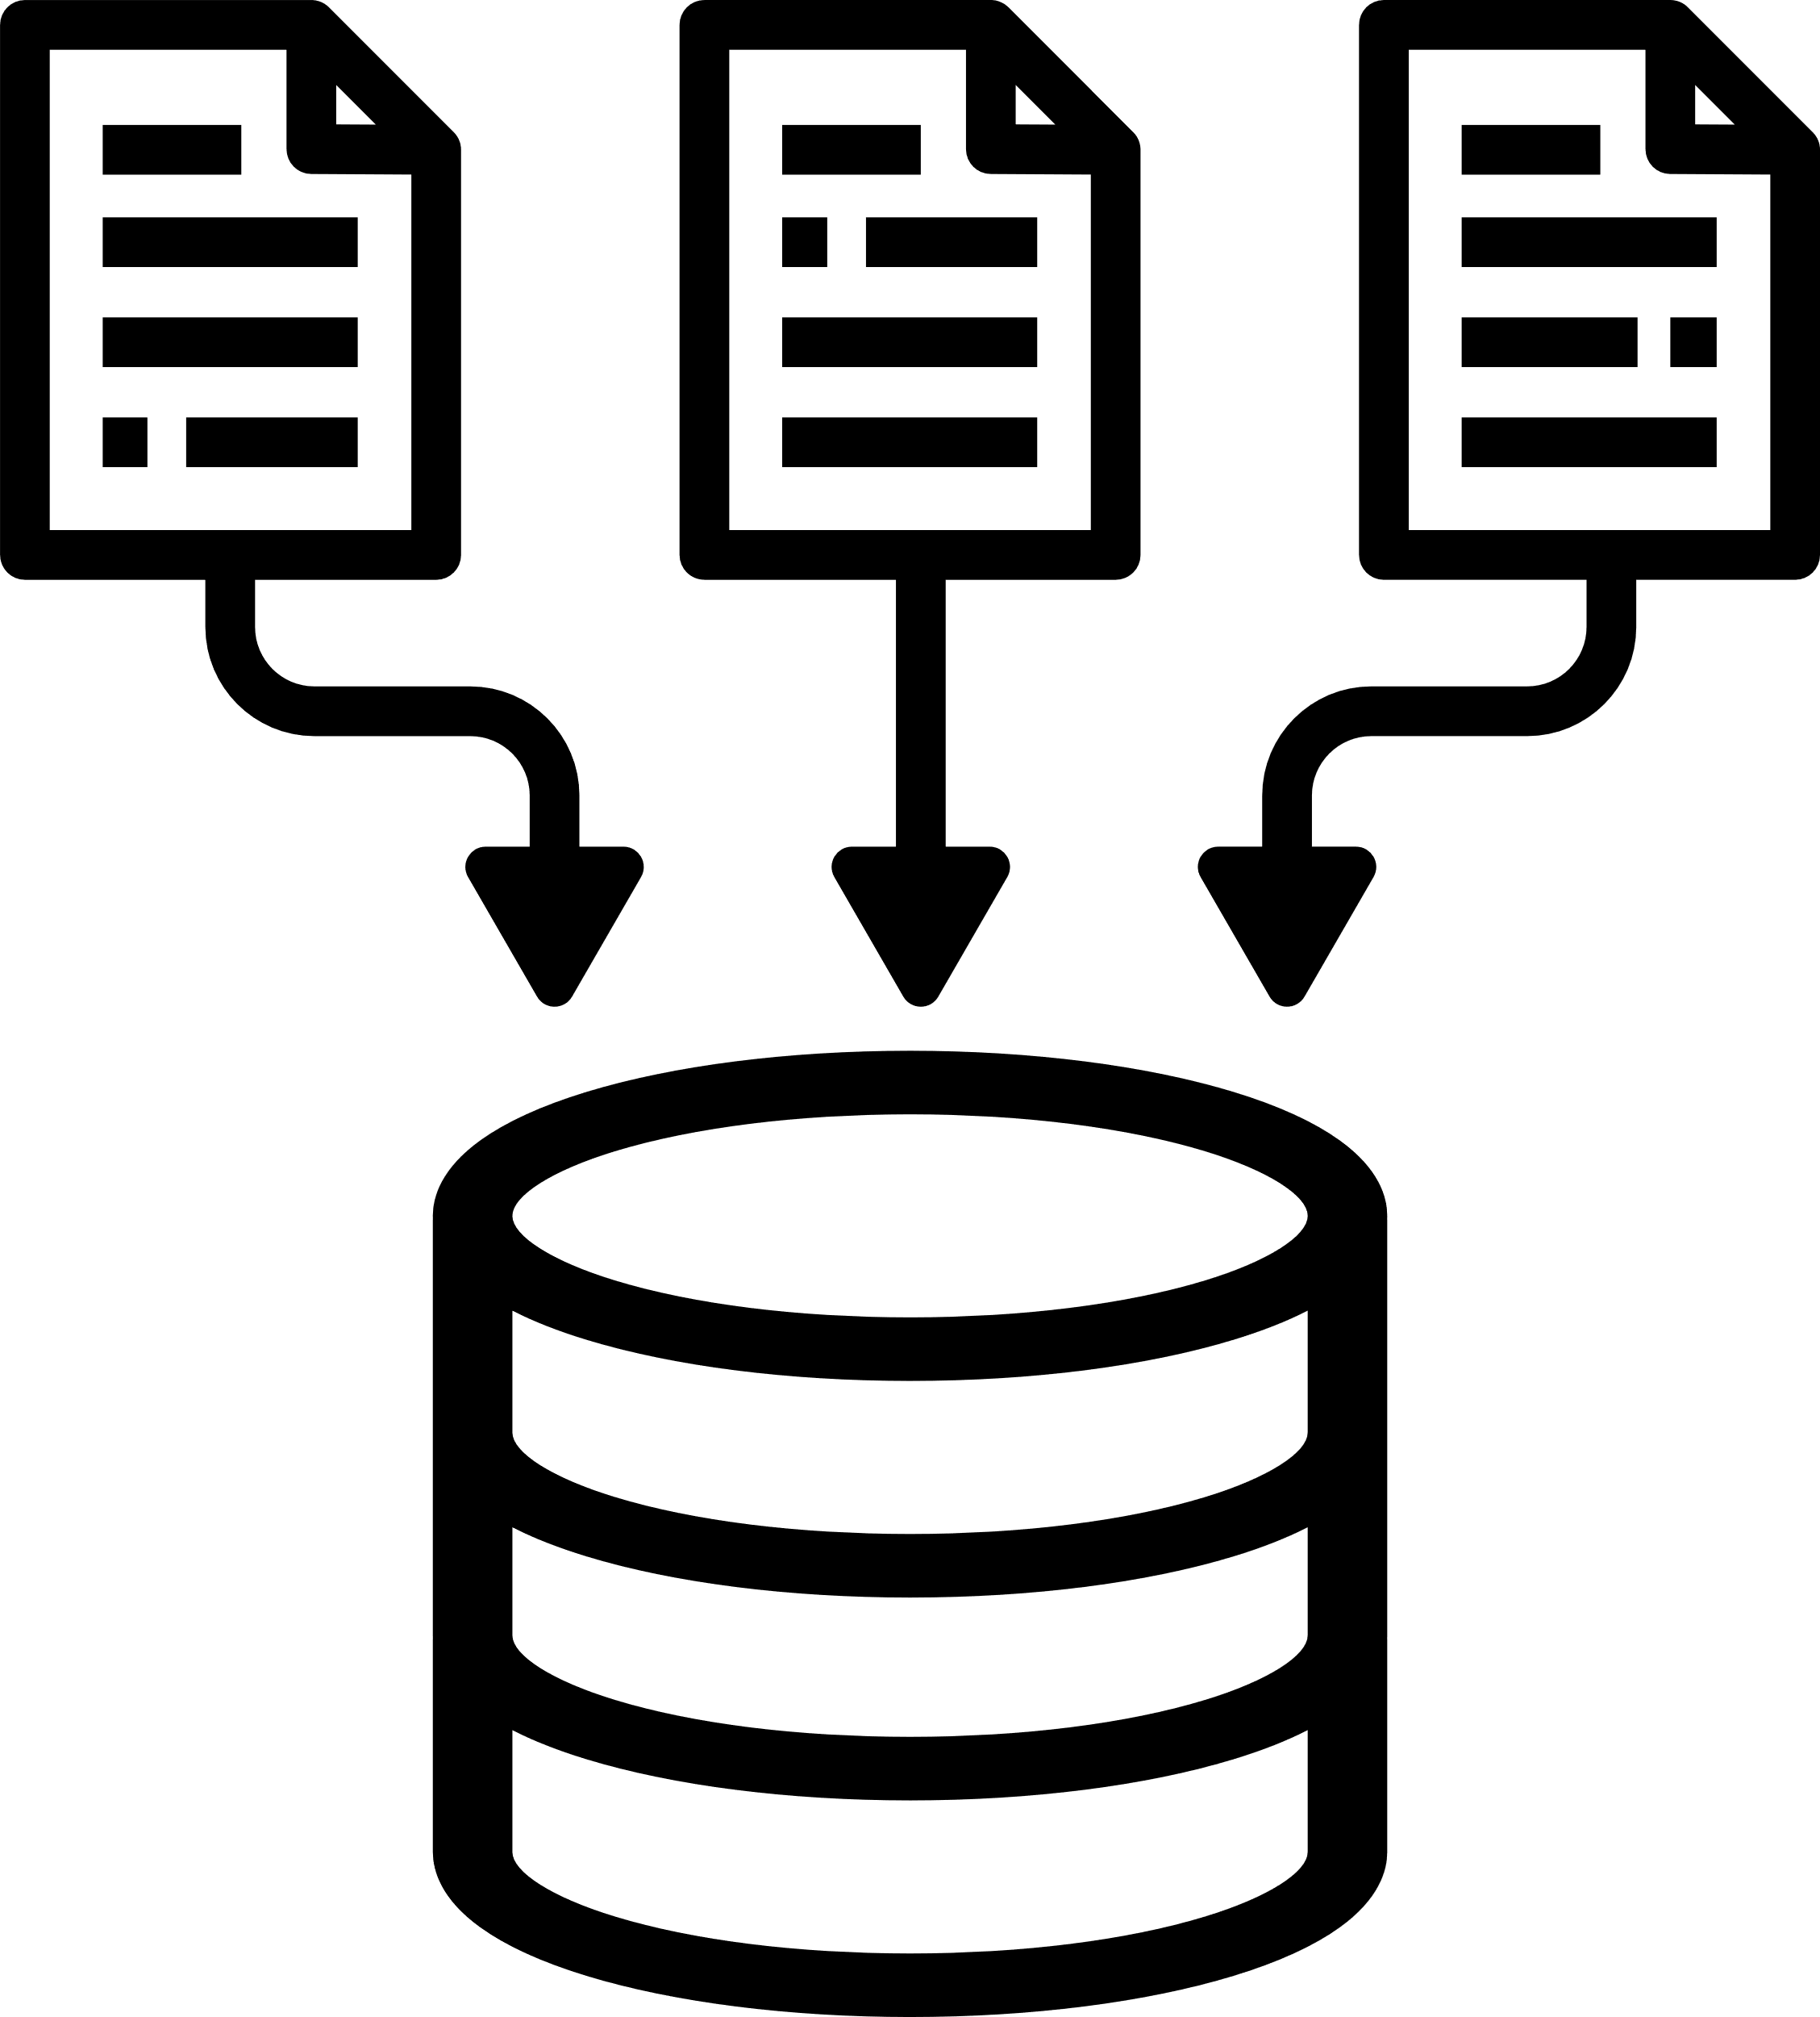



Phased Execution Strategy
Phase 1: Data Collection
Collaborating with authorities for traffic data.
Deploy sensors and cameras at key locations.
Phase 2: Model Development
Train AI/ML models on historical and real-time data.
Validate predictions with ground data.
Phase 3: Prevention System Deployment
Install warning systems, optimize traffic lights, and enable app notifications.
Phase 4: Dashboard Launch & Community Engagement
Provide tools for traffic management.
Conduct awareness campaigns about accident hotspots.
Project Timeline
March 2025
June 2025
Sept 2025
Nov 2025
Phase 1
Phase 2
Phase 3
Phase 4

Slide 7
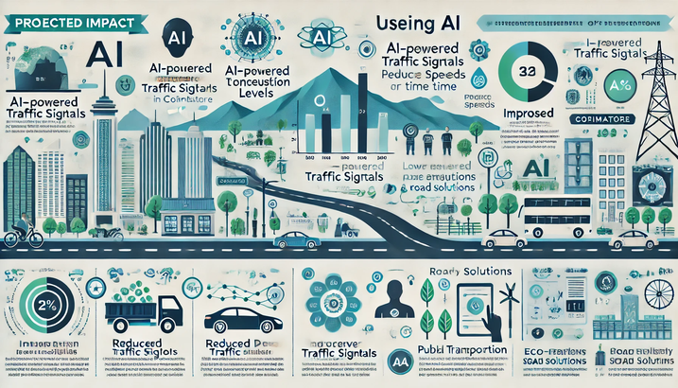
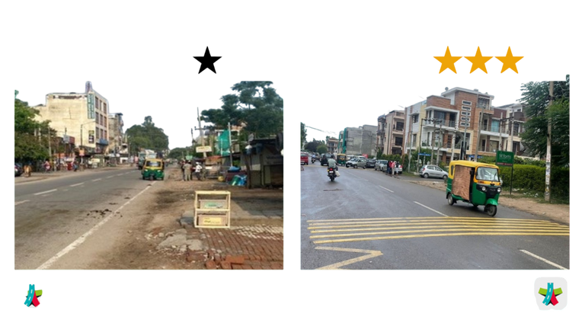
Transforming Road Safety in Coimbatore
Reduction in Accidents:
Fatalities at hotspots reduced by 30-40%.
Improved Planning:
Enhanced infrastructure and resource allocation.
Driver Awareness:
Increased knowledge of accident-prone areas and safety measures.
Data-Driven Governance:
Better traffic management and policy formulation.
Before: 1.0
After: 4.0

Slide 8

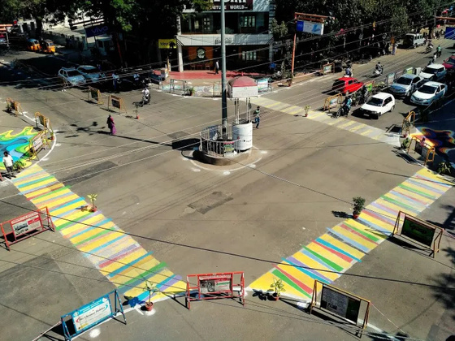
Join Us in Building Safer Roads
The proposed solution combines AI, IoT, and community involvement to address Coimbatore’s road safety challenges effectively.
With data-driven insights and preventive mechanisms, this system aims to set a benchmark for road safety initiatives.
“Together for a Safer Tomorrow.”

Slide 9

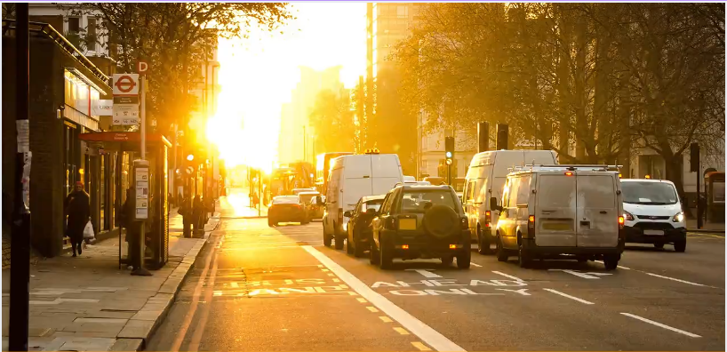
“Every step toward road safety counts—
THANK YOU
for inspiring us to take this one”
24f2002281@ds.study.iitm.ac.in
24f2008755@ds.study.iitm.ac.in

